Slide 1
Midterm Project Report of SUSTCraft
SUSTechers’ own Tower Defense and Strategy Game
E10 王超逸 杨英特 谢迈杰 周子越 张一驰
Contact: 11811014@mail.sustech.edu.cn

Slide 2
CONTE NTS
Destination we are heading for
Progress we have made
Future we will explore
Advice we want you to share

Slide 3
Destination
/ 01
Our destination is to build a
When you copy & paste, choose "keep text only" option.

Slide 4
Our Destination
Versatile towers and various corps;
Flexible tactics and complex terrain;
Symbolic races and diversified strategies;

Slide 5
Progress
/ 02
Through the tough days we’ve been, the progress is significant.
Thanks very much to our members’ extraordinary contribution!

Slide 6
Our Progress – the roadmap
Unity3D
SUSTCraft
Basic idea
Socket
Design

Slide 7
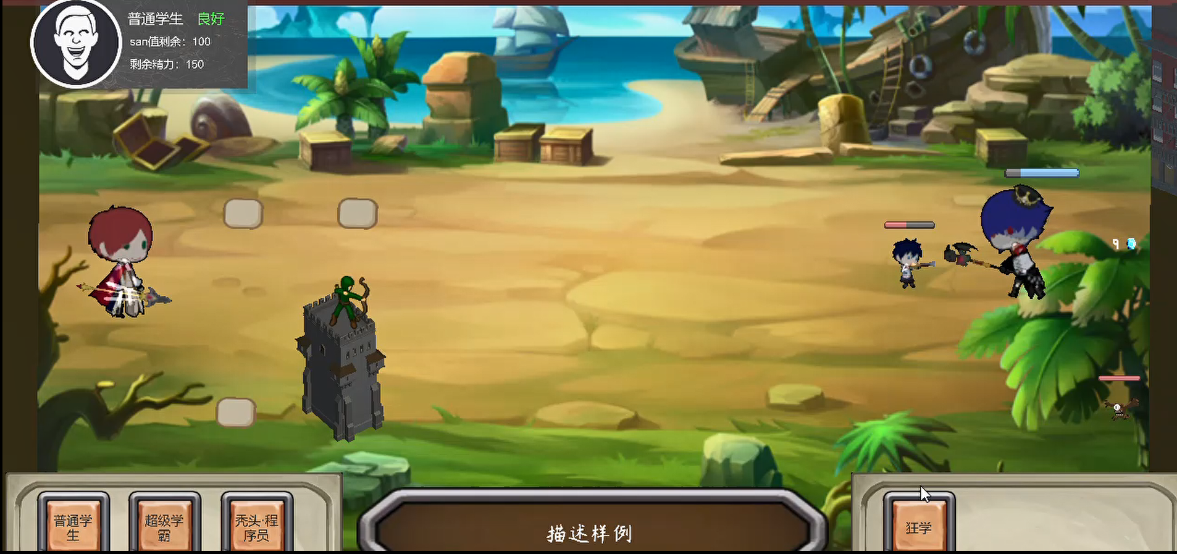
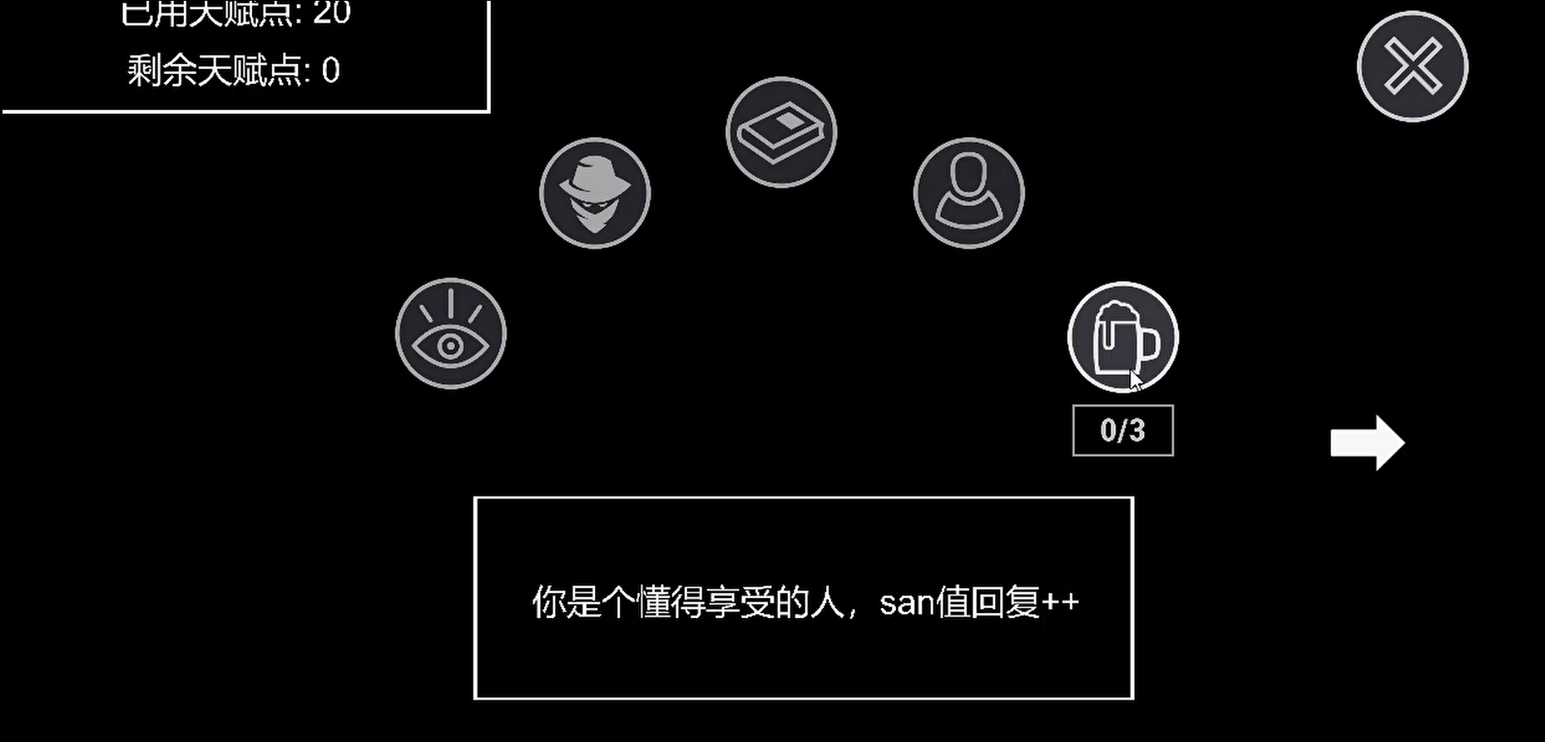
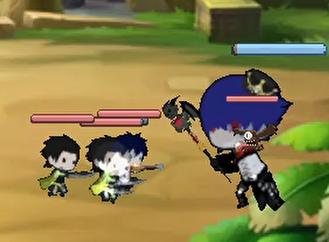
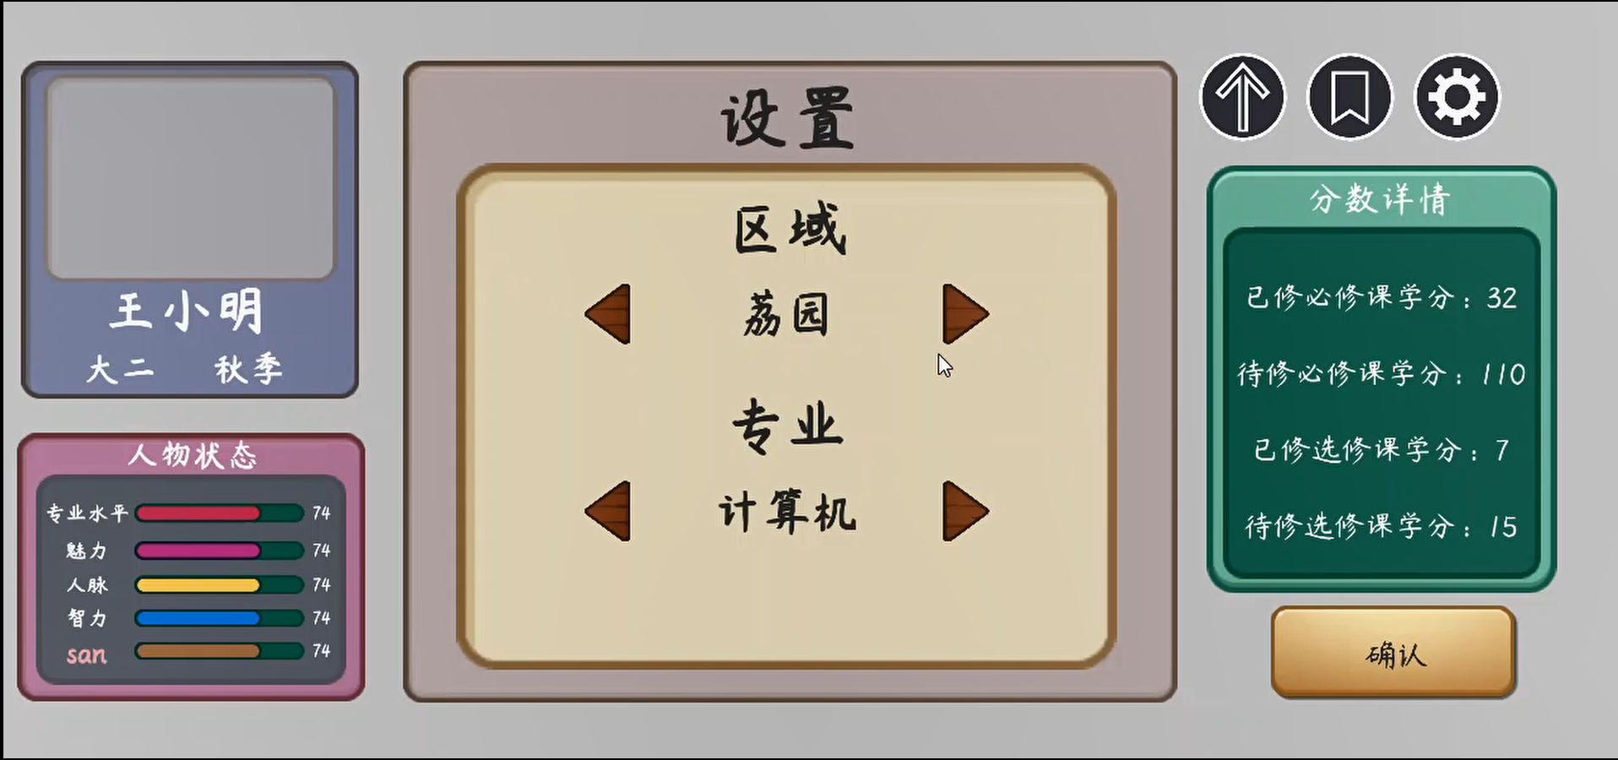
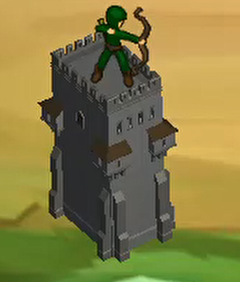
Our Progress – speaking of Unity3D
Please enjoy our demo first!

Slide 8
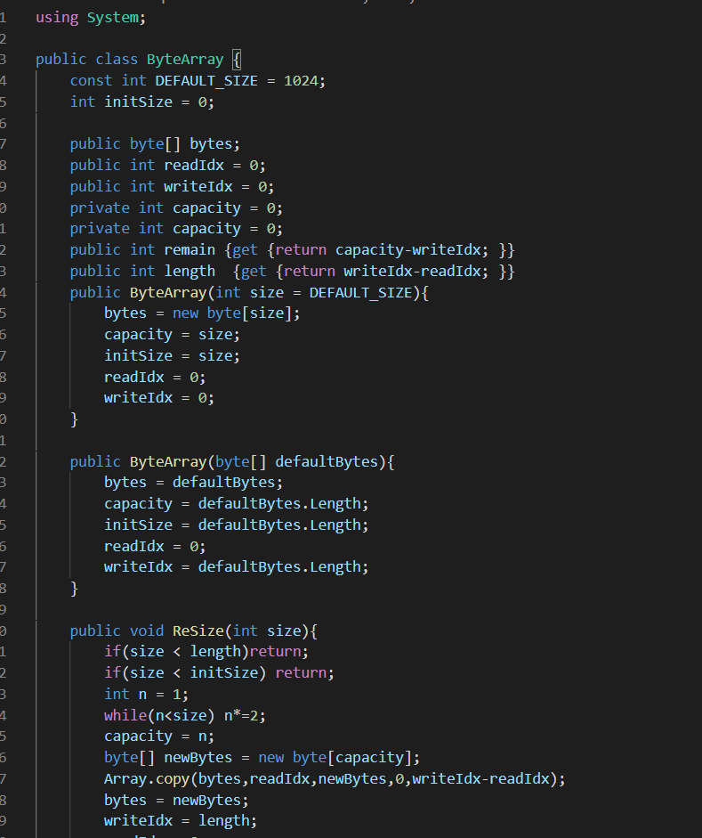
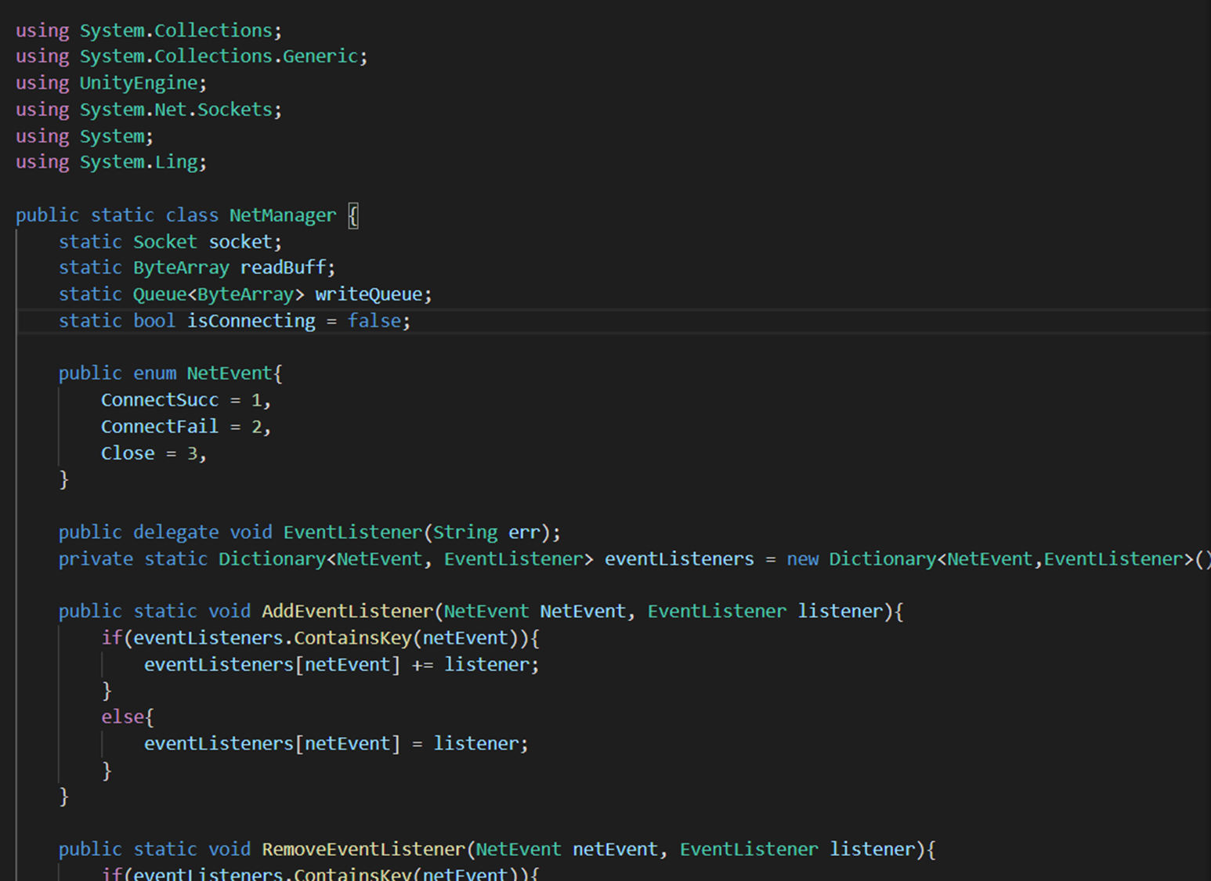
Our Progress – speaking of Socket
BytesArray Buffer Structure
NetManager Web Control
Protocol Base: MsgBase,
Universal Service Terminal……

Slide 9
Future
/ 03
We have made significant progress on our project…
…even though, there are still plenty of TODOs and ambitions to be realized.
Notes:
到目前为止，我们的工作还有很多需要改进合优化的地方，以及一些任务还有待完成。

Slide 10




Our Future –The UI of the main interface
Setting:
set the background music
set the sound of combat
set the player accounts(in online battle)
……
Optional：
record the historical battle
record the achievement of battle
record the level, experience e.t.c. of player(in online battle)
Helper : (Have not been written in UI yet)
pop up the help pages automatically when firstly open the game
if you want to read the help pages, you can click it.
Notes:
首先，在主页面的UI内还有一些按键的功能没有完善。一个是setting界面，这里有BGM的控制，音效的控制和联机模式的一些设置。同时还有optional功能，这里可以调取你的游戏记录，比如历史对局，和例如杀敌数这样的一些有趣的记录。另外，我们还需要一个帮助的功能。而且在第一次可以自动弹出帮助的这个页面。

Slide 11
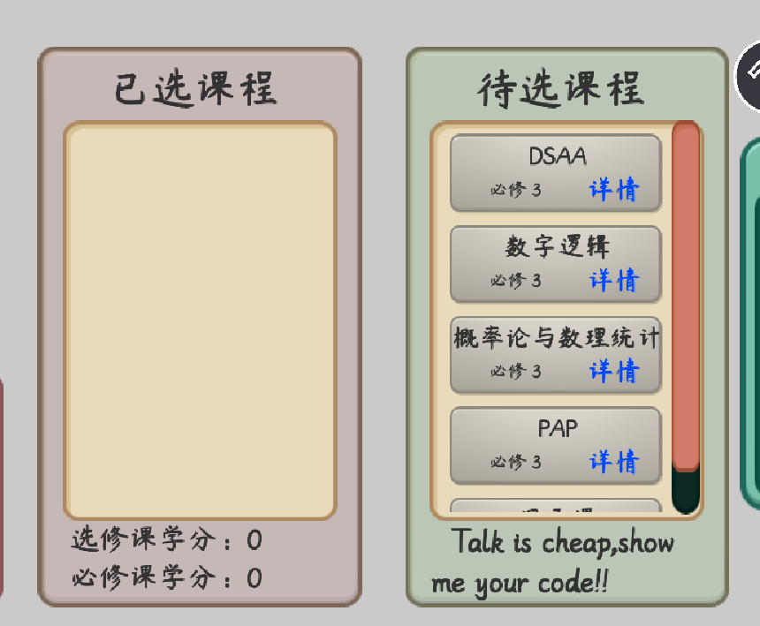
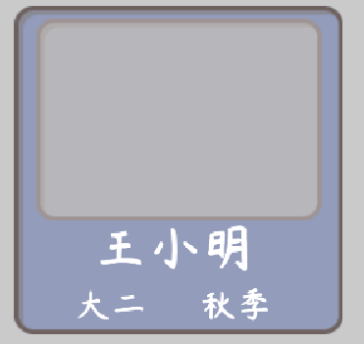

Our Future –The UI of the main interface
Player:
change head of picture
change the name of player
more level of player(such as 大三）
log in and register(maybe)
associated to online mode
Course:
more types and number of courses (level mode)
preview, unlock and select the tree of the courses
Improve course description and introduction
the feedback after choosing course (sound)
Notes:
同时，主页面UI内的选课页面的介绍还比较粗浅，我们暂时跳过了这一部分，后面会具体加上对游戏的影响和更多的课程，也会把课程的选项做出一个类似于科技树的形式，层层解锁选择。
而且在player页面也会加上头像的选择甚至上传，也会根据让年级的显示根据你的游戏进度动态的变换

Slide 12
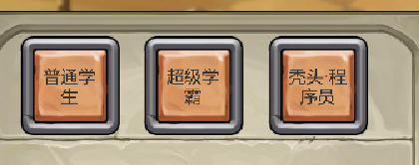
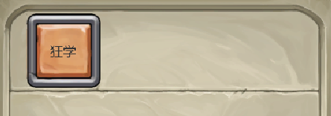
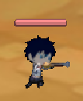
Our Future – The UI of the battle scene
Solders Build :
additional and optional solders
improve the name of the solders
description pages when mouse keeping over
Solders :
additional soldier's model
more soldier animations(died, attack, failure and victory)
the feedback after building a solder(cost, sound)
Skill :
additional and optional skills
improve the name of the skill
description pages when mouse keeping over
Notes:
在兵种和技能的页面，我们的部分单位还没有匹配的图片素材。同时也没有设计足够丰富多样的兵种和技能，我们打算继续寻找需要的素材库，也会考虑自行剪裁设计兵种和技能素材；同时还需要增加的，有一个是悬停可以显示说明的页面。另一个是兵种建造，死亡的音效反馈。

Slide 13
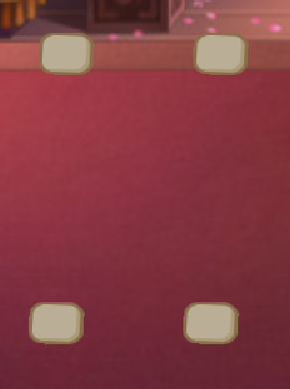
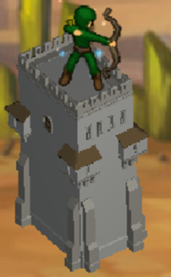
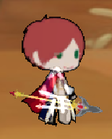
Our Future –The UI of the battle scene
Tower Build :
additional and optional towers
complex and different locations
improve the name of the solders
description pages when mouse keeping over
Tower :
additional and optional tower's model
complete dismantled and upgraded pager
the feedback after build, operate (sound)
Hero :
additional hero's model
more hero animations(died, attack, failure and victory)
the feedback after using a skill(sound)
Notes:
塔和英雄也是素材和种类不足，缺少反馈，没有悬停说明，这些也会在后三周增加完善。
并且建造塔的位置我们会根据背景有不同多样的样子。

Slide 14



Our Future – Other work in this game
Background sound :
a lot of different BGM can be choose and change in setting scene
different BGM in the failure and victory scenes
different sound in the build solder, tower and skill
Cutscene :
failure and victory cutscene
loading cutscene
other cutscene(such as in online mode)
More work of the online battle:
how to choose the opponent(random or private rooms) in a online page
the information of the opponent’s player should be showed in battle UI
balance and fun in the online battle
Notes:
同时，在这两个ui之外，我们还有音效和过场动画的不足。目前我们都还没有做BGM和音效嵌入。这些也会在后三周把它做出来。同时我们的sustech craft的胜利和失败的过场页面，loading页面也还没有做完。同时我们的网络部分也有很多需要完成的工作。之后的三周会晚上这些问题和不足

Slide 15
Advice
/ 04
Please share your precious advice with us!!!
We treasure your opinion to the largest degree!!!

Slide 16
Thanks Please await our work!
E10 王超逸 杨英特 谢迈杰 周子越 张一驰
Contact: 11811014@mail.sustech.edu.cn

